Slide 1

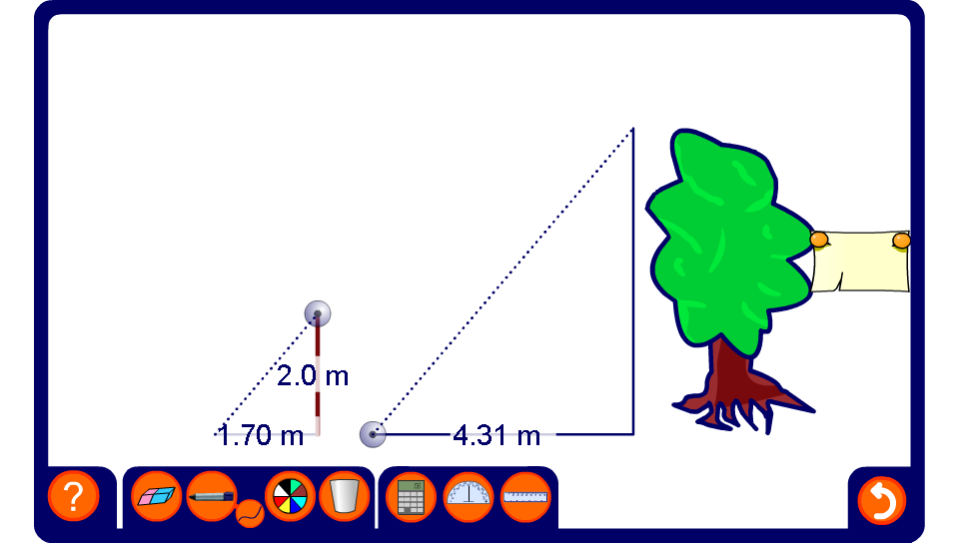


Using shadows to measure height
Notes:
Stress that if the stick and the tree are close to each other the ratio between the stick’s height and its shadow is the same as the ratio between the tree’s height and its shadow. The length of the shadows depends on the position of the sun.
Discuss how we find the height of the tree given the height of the stick and the lengths of the two shadows.
Change the heights and shadow lengths to modify the problem.

